Slide 1


Slide 2

Notes:
We are electrical industries charity – and industry charity for industry people, bringing industries together to help their own by providing a variety of practical support and emergency financial relief to people who work in electrical industry and their immediate families

Slide 3
Notes:
The EIC has been in existence for over 100 years and was started when 10 industry colleagues saw people in need and put £10 each together to start an Electrical Trades Benevolent Institution in 1905.
Over the years we have had different names, until 2014 when we rebranded and are since called Electrical Industries Charity, but our mission remains the same: to help people in need.
Prior to 2014 the focus was very much on financial grants but since then we have worked hard towards prevention and educating people in the importance of mental health and wellbeing.
We will continue to grow and evolve with the industry and hopefully with the help of our industry be around for 100 more years

Slide 4

Notes:
Our strategy remains to support our industry members who have fallen on hard times with impactful solutions.
We aim to provide value through our vast resources and strong partnerships. We are using our resources effectively and efficiently to future proof our charity for years to come.
We partner with experts across various fields – from mental health professionals, to cv and will writing service providers and debt and financial advisors. For example, we partner with an expert in financial planning, who aims to help people avoid financial hardship and achieve a rewarding and secure future.

Slide 5

An industry charity for industry people
To keep our free and confidential services available to the industry organisations and individuals, to help the Charity in many ways.
This could be financially through participating in, donating to and promoting fundraising initiatives across the sector. It could be through championing the Charity in the sector as an ambassador, ensuring a wide presence in all industries.
How can you support Corporate Social Responsibility (CSR) in your business?
By supporting the charity, you are donating directly to the industry and your entire supply chain. You are assisting in continuing and developing education and training in our industry such as Mental Health training and financial assistance to those in our industry that
have fallen on hard times.
Your employees are all eligible for support from the charity and most importantly you are becoming an industry leader, you are showing the importance of giving back to our community and specifically our industries Charity which was created by industry members to serve industry members.
Notes:
The EIC are an industry charity for industry people and support anyone who works in the electrical industry when they have fallen on hard times.
All of our services are free and confidential, and we rely solely on fundraising. We are lucky that we have a very generous industry and work hard to build and maintain our relationships.
Any support companies give to the charity counts towards their CSR and their employees have access to all of the free support services.

Slide 6
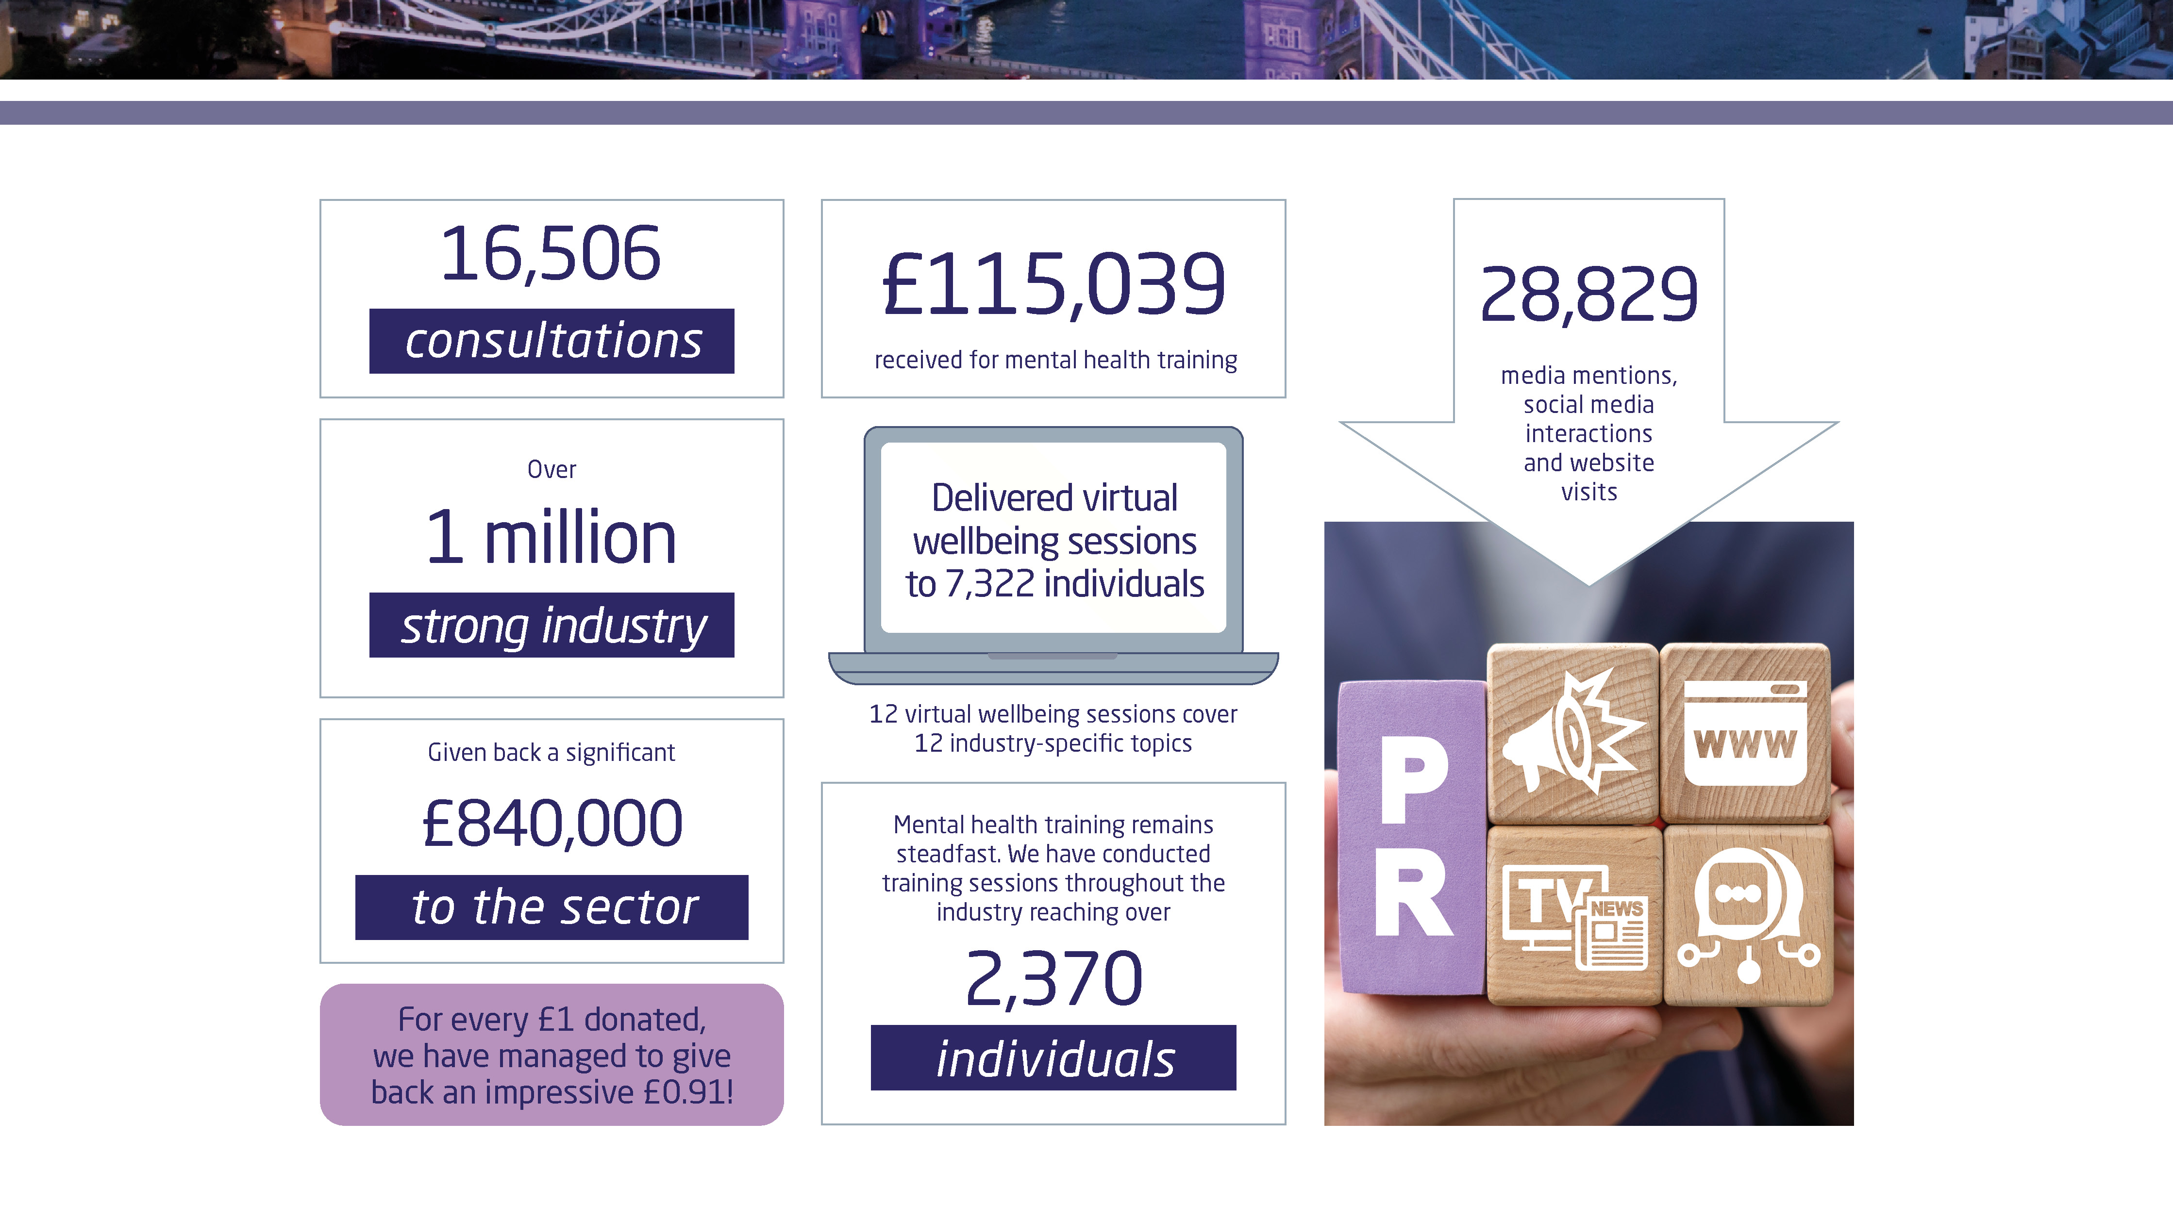

Slide 7


Slide 8
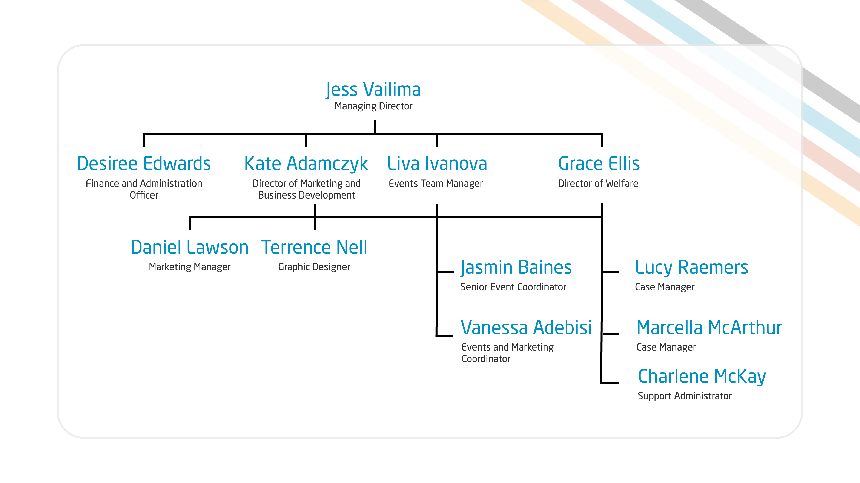
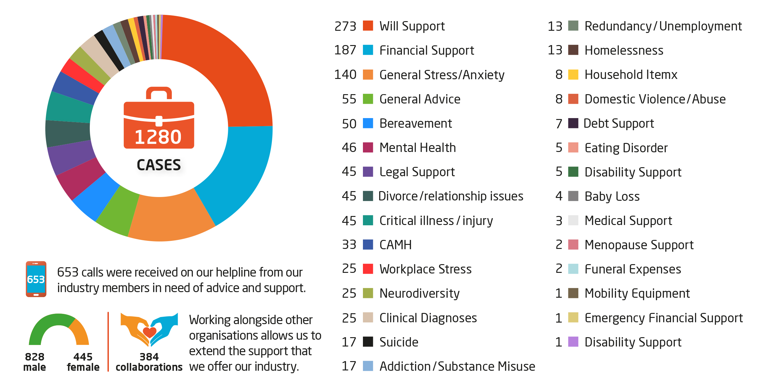
Standing by our Industry: 2025 in Review
Notes:
The EIC is a small team of 13 people for an industry of over 1 million people.

Slide 9
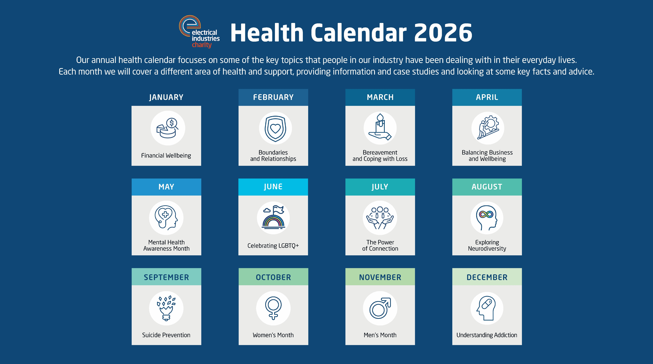
Notes:
Early detection and early intervention is the key to effectively supporting our industry. One of the ways we try to do this is through the Health Calendar that covers a variety of key topics that are relevant and based on trends that we are seeing across the sector. They provide information and practical tips on a variety of topics that change each year and are available on our website.

Slide 10

Notes:
Alongside our health calendar, we offer monthly wellbeing talks free of charge for anyone in the industry. They take place every first Wednesday of the month from 12-1pm.

Slide 12
Notes:
This month we talk about suicide prevention and our next wellbeing talk will be on Domestic Violence
If you’d like to join these talks please scan the QR code or leave your email address at the end of the presentation and I will make sure you get details on this

Slide 13


Slide 14
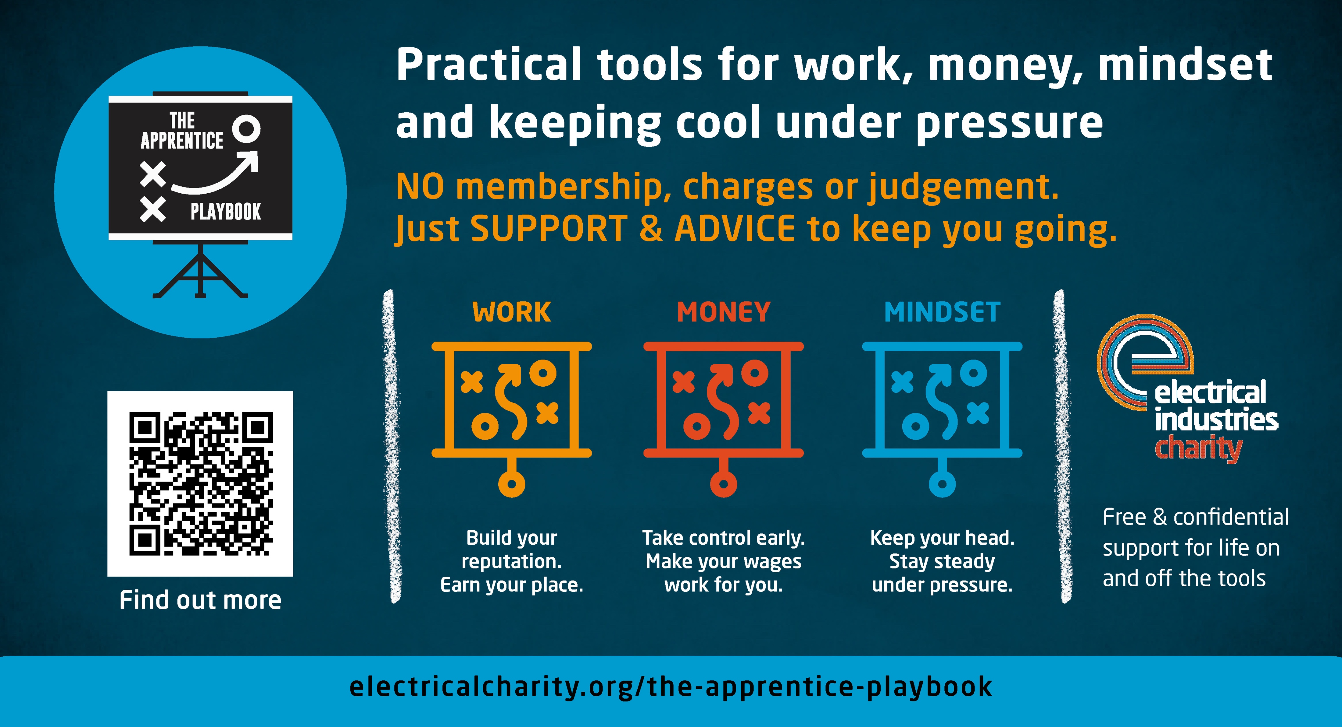

Slide 15


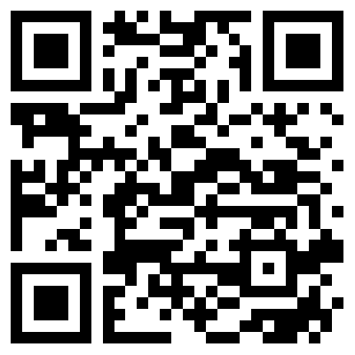


Challenge for a Cause
26th April 2026
5 people running for EIC
8th May 2026
Reg Fee: £100
Fundraising Target: £500
Scan for more information and to sign up!
https://electricalcharity.org/challenge-for-a-cause/
Edinburgh Kiltwalk 2026
13 September 2026
Reg fee: £20
Fundraising target: Do your best for EIC
1st-10th October 2026
Reg Fee: £600
Fundraising Target: £5k
Notes:
These are our challenge events for 2025/2026. talk through each.
Here are all the challenge events for 2026.
London Marathon – 5 people are running for EIC. They are training hard and well on the way with their fundraising journey. Please support them in their fundraising efforts, if you can.
Snowdon by Night – We are heading to Snowdon in May and have had amazing up take on the challenge with 40 people taking part.
Kiltwalk – as discussed last year and after a great success with Glasgow Kiltwalk last year, we are advertising Edinburgh Kiltwalk this year. So far we haven’t had any sign ups yet, if you could please put this out to your contacts that would be great.
6 people have signed up to do Glasgow Kiltwalk again this year. ONLY IF ASKED: Team Aico – Tony Boyle, Rory Fraser, Andrew Sturgess, Daniel Little, Tristan Potkins, Gareth Iveson
Vietnam – Our big international challenge for 2026 is Vietnam Pu Luong Trek. Trek 100km over 6 days in heat and humid conditions. tough long days of hiking on average 16-18km/ 6-8h a day, with beautiful views along the way. So far 8 people have signed up and we would love to see more joining us! If you are interested or know anyone that would love to do this, please let us know.
Anyone can sign up for these challenges and you’ll be fully supported from start to finish. We’ll help you with your fundraising, setting up a fundraising page for you, creating marketing materials for you to use and promoting you across our channels. We’ll be with you to help with training plans and full briefings on the run up to the challenge. We don’t believe in sitting on the sidelines but instead will be right there with you, pushing ourselves to the limit together.
If you’d like to sign up to any of these, please email us or follow the QR code

Slide 16
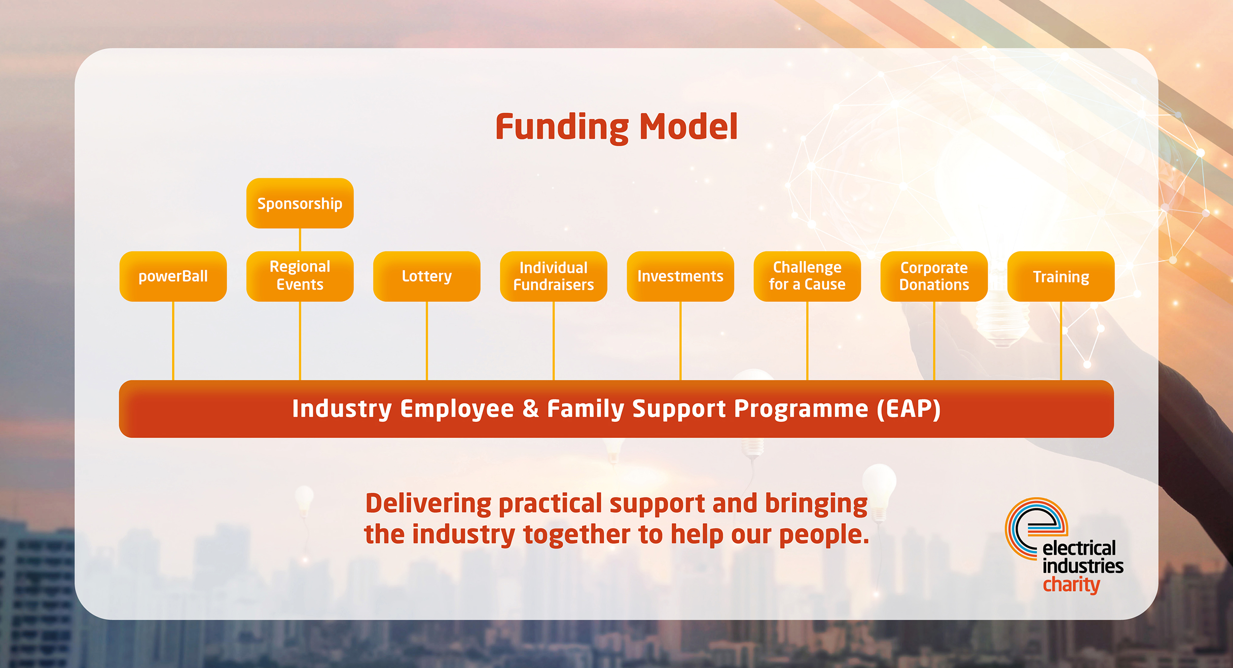
Notes:
The EIC rely solely on fundraising and we couldn’t do the great work for the industry without the support of the industry.
Events are one of the largest fundraising streams, with powerBall being our flagship national event and the biggest fundraiser. Alongside this there are approximately over 30 regional events up and down the country that we put on with the help of our regional committees. Companies can attend events or become a sponsor.
Included in events are the ‘Challenge for a Cause’ trips, we do 3 a year (London Marathon, UK based and bucket list) and have been to some iconic places, such as Everest Base Camp and Machu Picchu. Companies can be a challenge for a cause sponsor and be promoted across all 3 trips.
The powerLottery is a great way for individuals and businesses to get involved, it’s a £1 a month and you have the opportunity to win up to 30 cash prizes every month. Businesses can offer it to their employees via their payroll.
The EIC have lots of ideas and resources for individuals who want to fundraise for them, all available on the website.
Like many charities they have investments that yield a return to top up any funds needed.
Challenge for a cause –
Corporate donations are a big part of the EIC funding and is the most straightforward way to support your industry charity. This can be done at any time throughout the year and companies are entitled to tax relief for qualifying charitable donations made to charities. Donations can also be linked to corporate fundraising or having the EIC as the charity of the year.
Educational Partnerships give companies access to the EIC’s marketing / campaign content, which is largely focused on mental health & wellbeing. There is also the option for joint campaigns and is a great opportunity to look after your employee wellbeing and CSR.

Slide 17


Slide 18
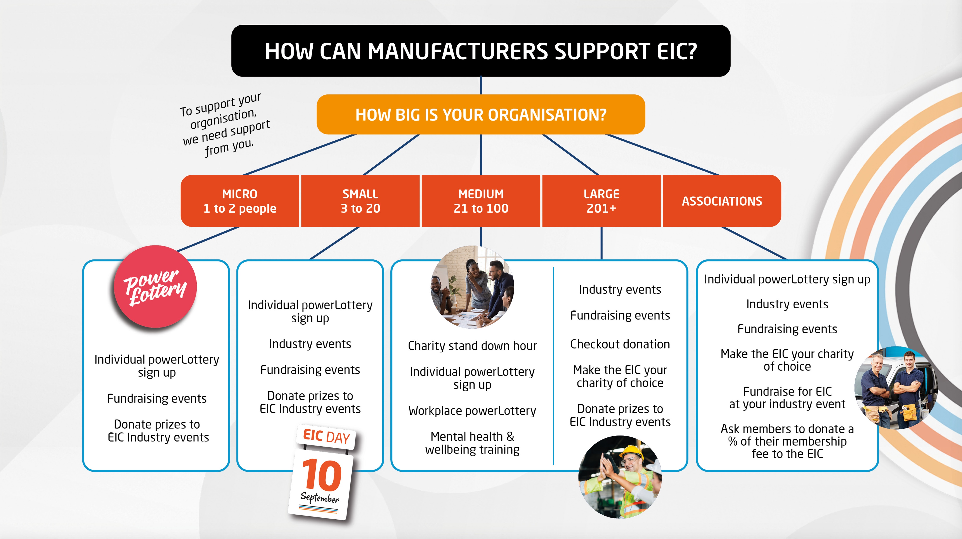
Notes:
As we’ve just talked through there are lots of ways you can support the EIC, whether you are a wholesaler, manufacturer or contractor and whether you are large or small.

Slide 19
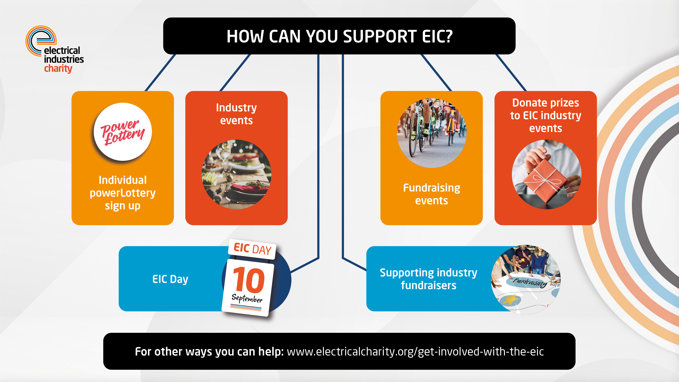

Slide 20

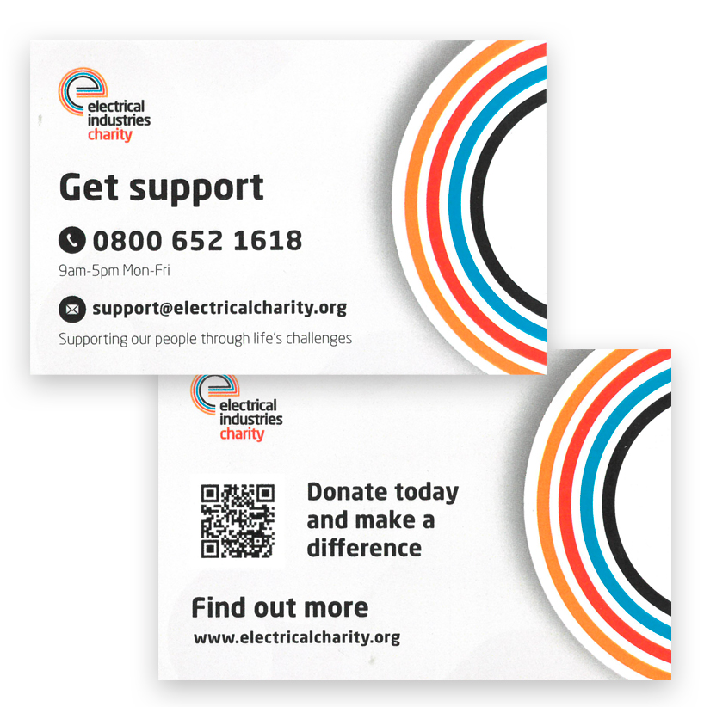
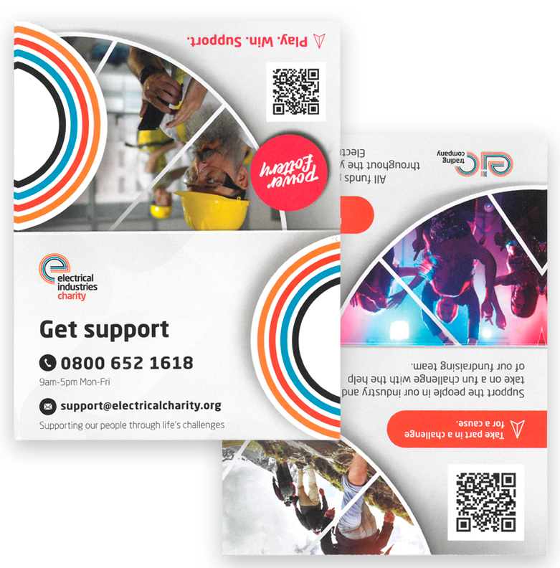
Resources
Posters – printed & digital
Leaflet –
printed & digital
Online portal for print materials:
https://eic.pdsplus.co.uk/
Digital resources:
https://electricalcharity.org/marketing-pack/
Wallet card - printed & digital
4 page Wallet card - printed & digital
Notes:
We have lots of resources available for you. These include posters, leaflets, wallet cards and digital material.
We really believe in Standing Together and providing you with the tools to help us spread the word.

Slide 21
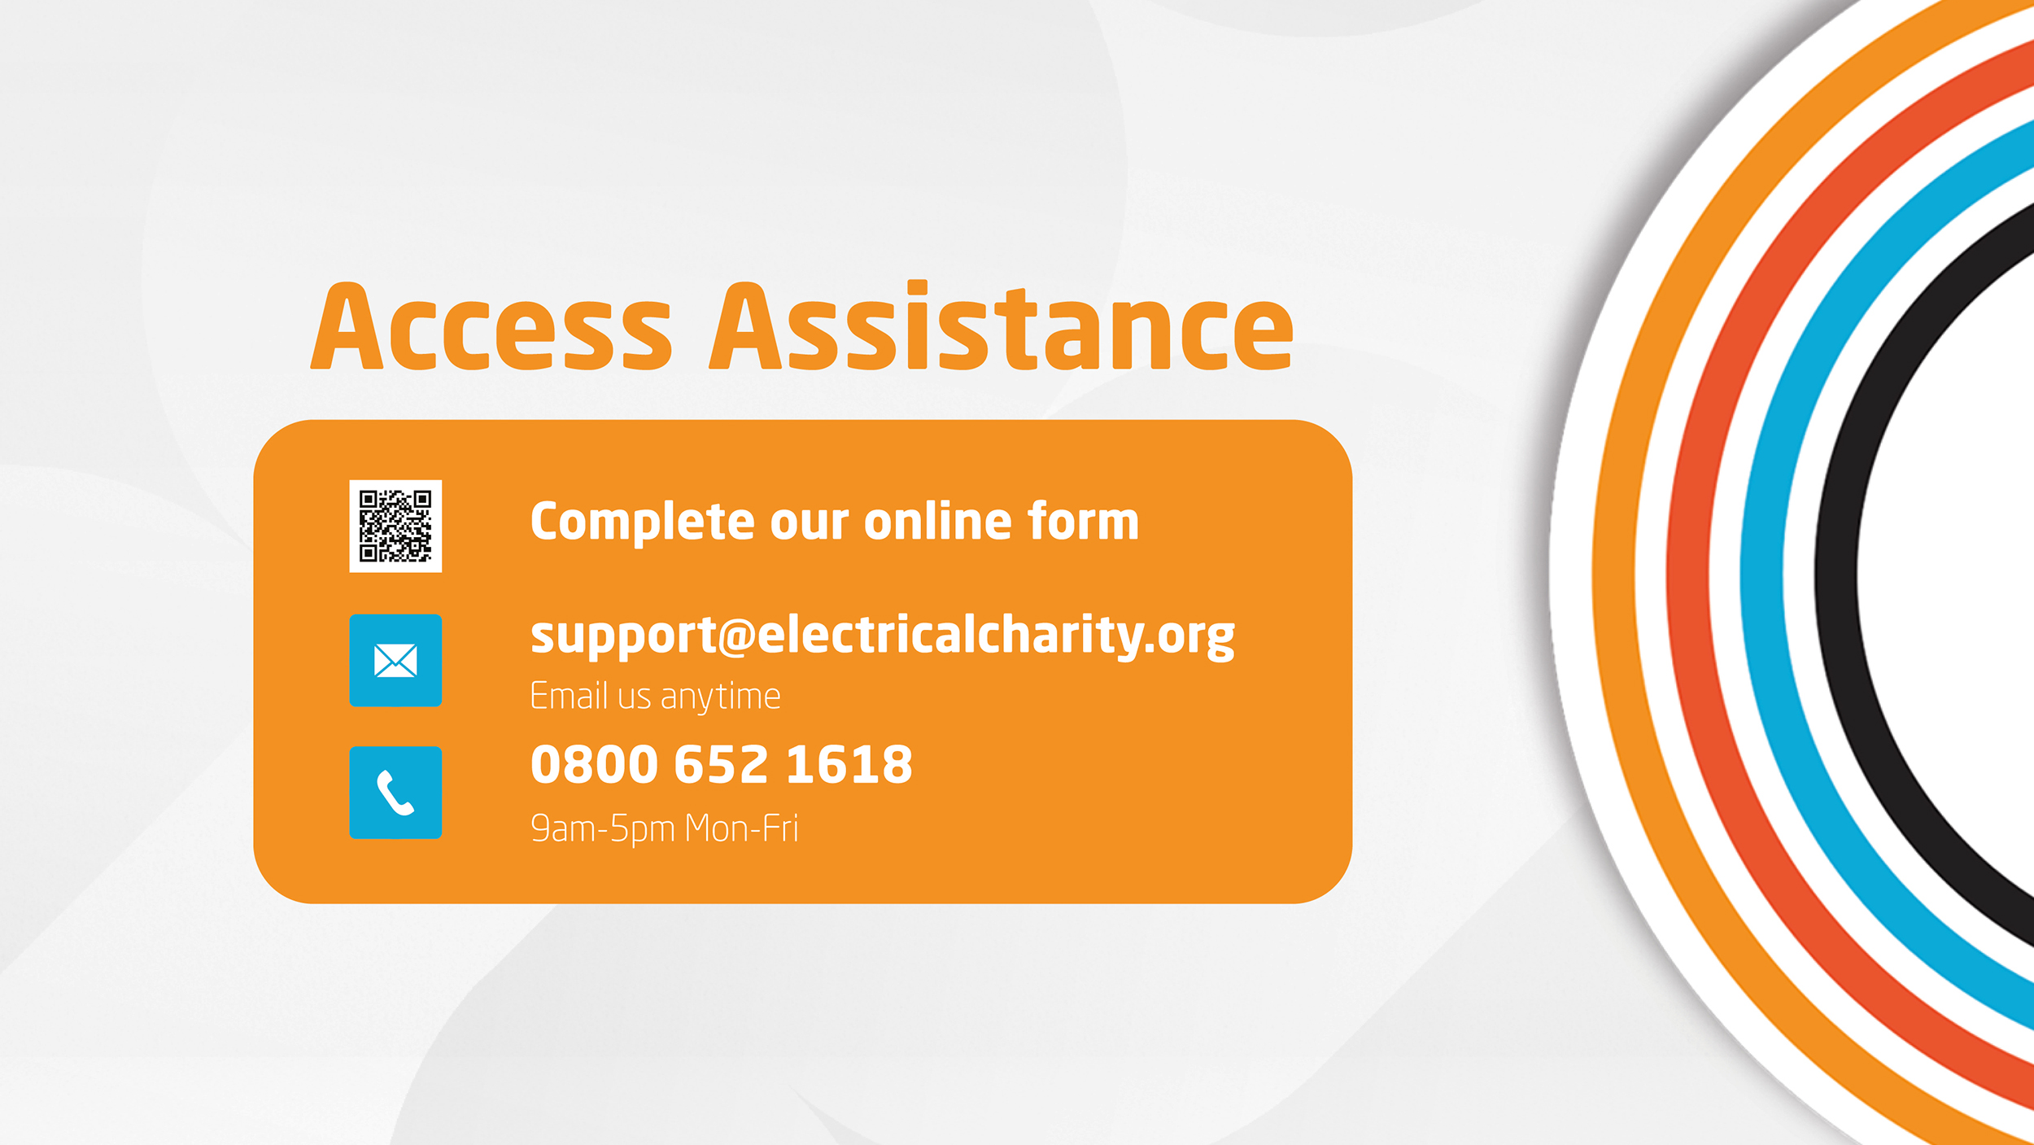
Notes:
People can access the charity via a free helpline that is open Monday – Friday, 9am-5pm, online form or via email.

Slide 22


