Slide 1
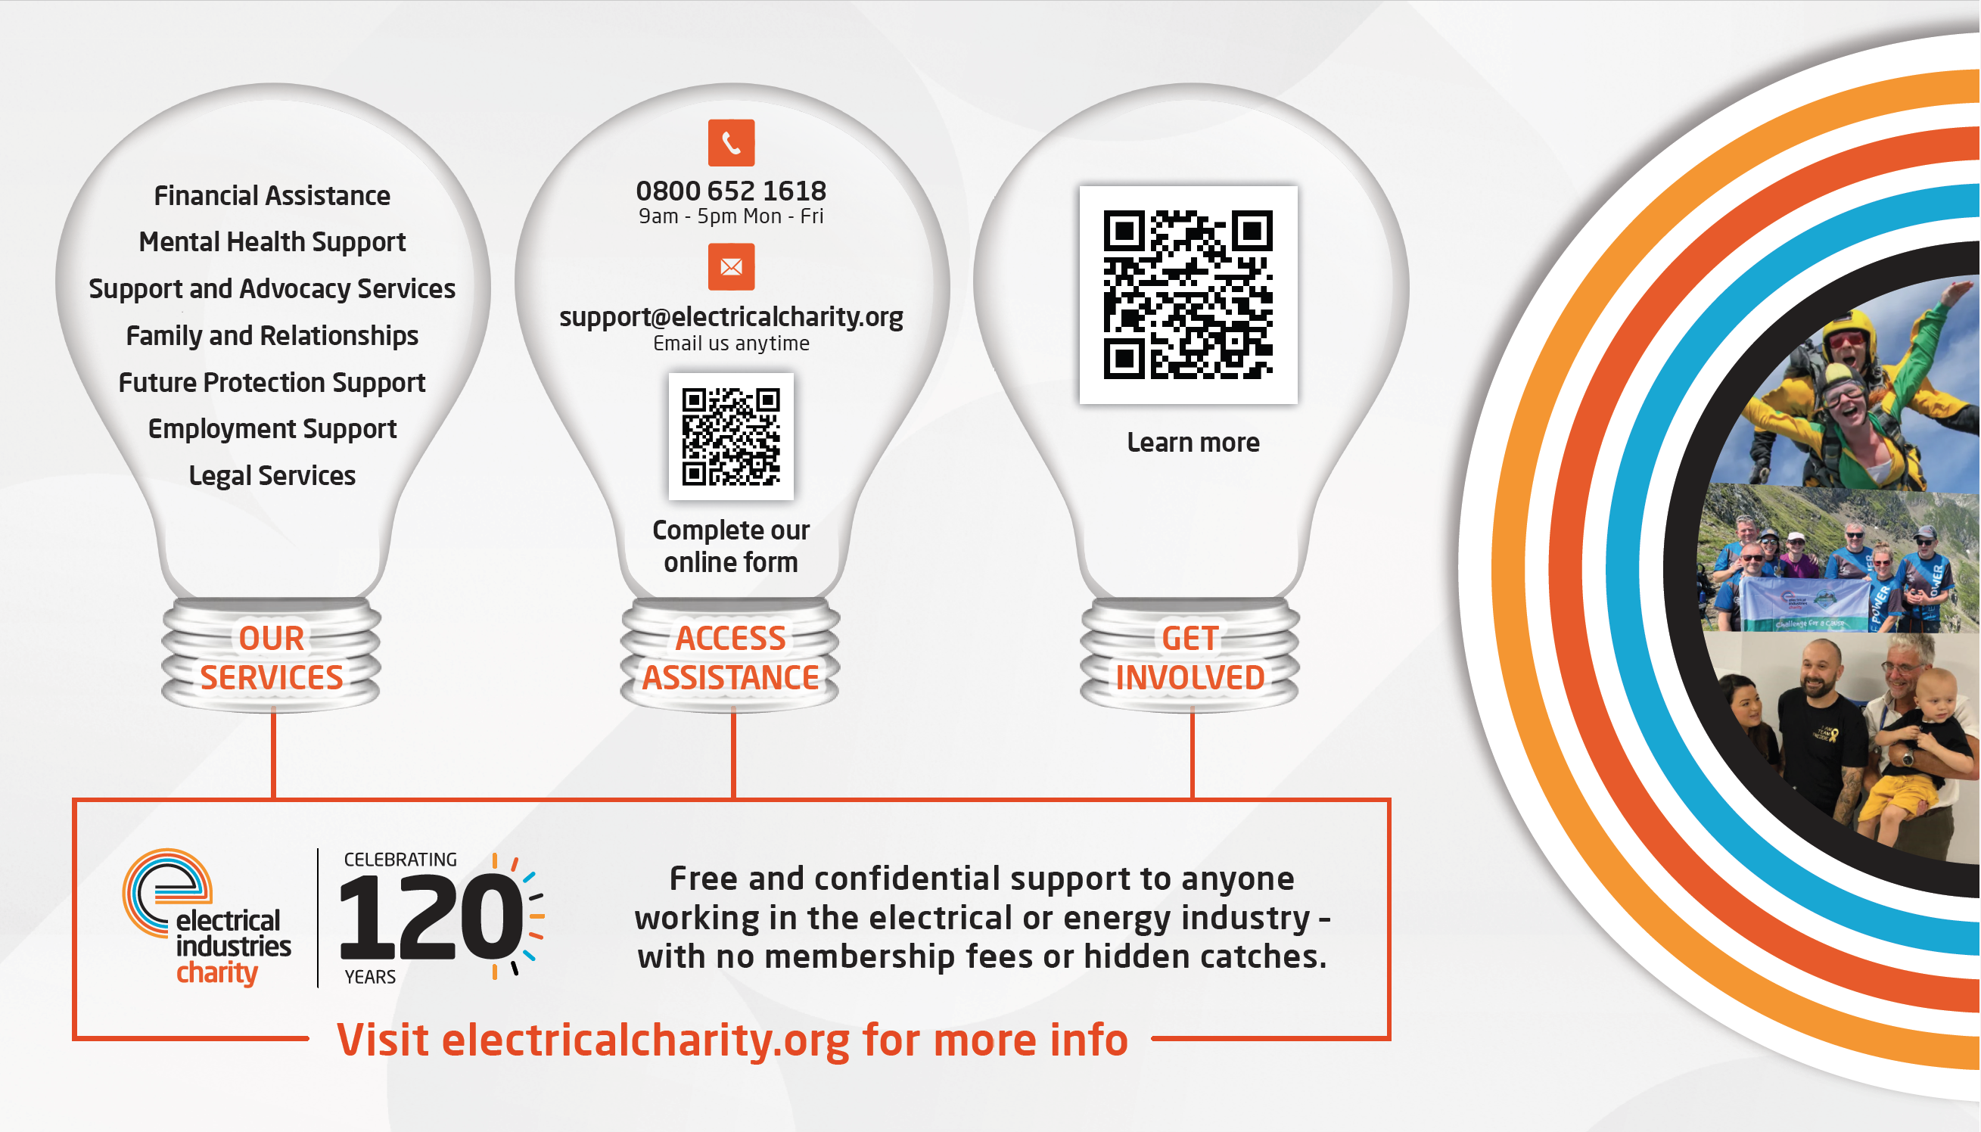
Notes:
The EIC offers free and confidential support to anyone in our industry – with no membership or hidden catches.
They offer a wide range of services, including mental health support, legal advice, as well as emergency financial assistance.
They’re there to weather the storm with you whatever challenges you’re facing.
You can access the charity by completing the online form, emailing them or calling the helpline (Monday – Friday, 9am – 5pm).
If you want to get involved or find out more information scan the QR code or visit their website.

