Slide 1


Slide 2


Slide 3
Notes:
The EIC has been in existence for over 100 years and was started when 10 colleagues saw people in need and put £10 each to help them.
Over the years we have had different names, but our mission remains the same: to help people in need.
Prior to 2014 the focus was very much on financial grants but since then we have worked hard towards more prevention and educating people in the importance of mental health and wellbeing.
We will continue to grow and evolve with the industry so we will be around for the next 100 years.

Slide 4
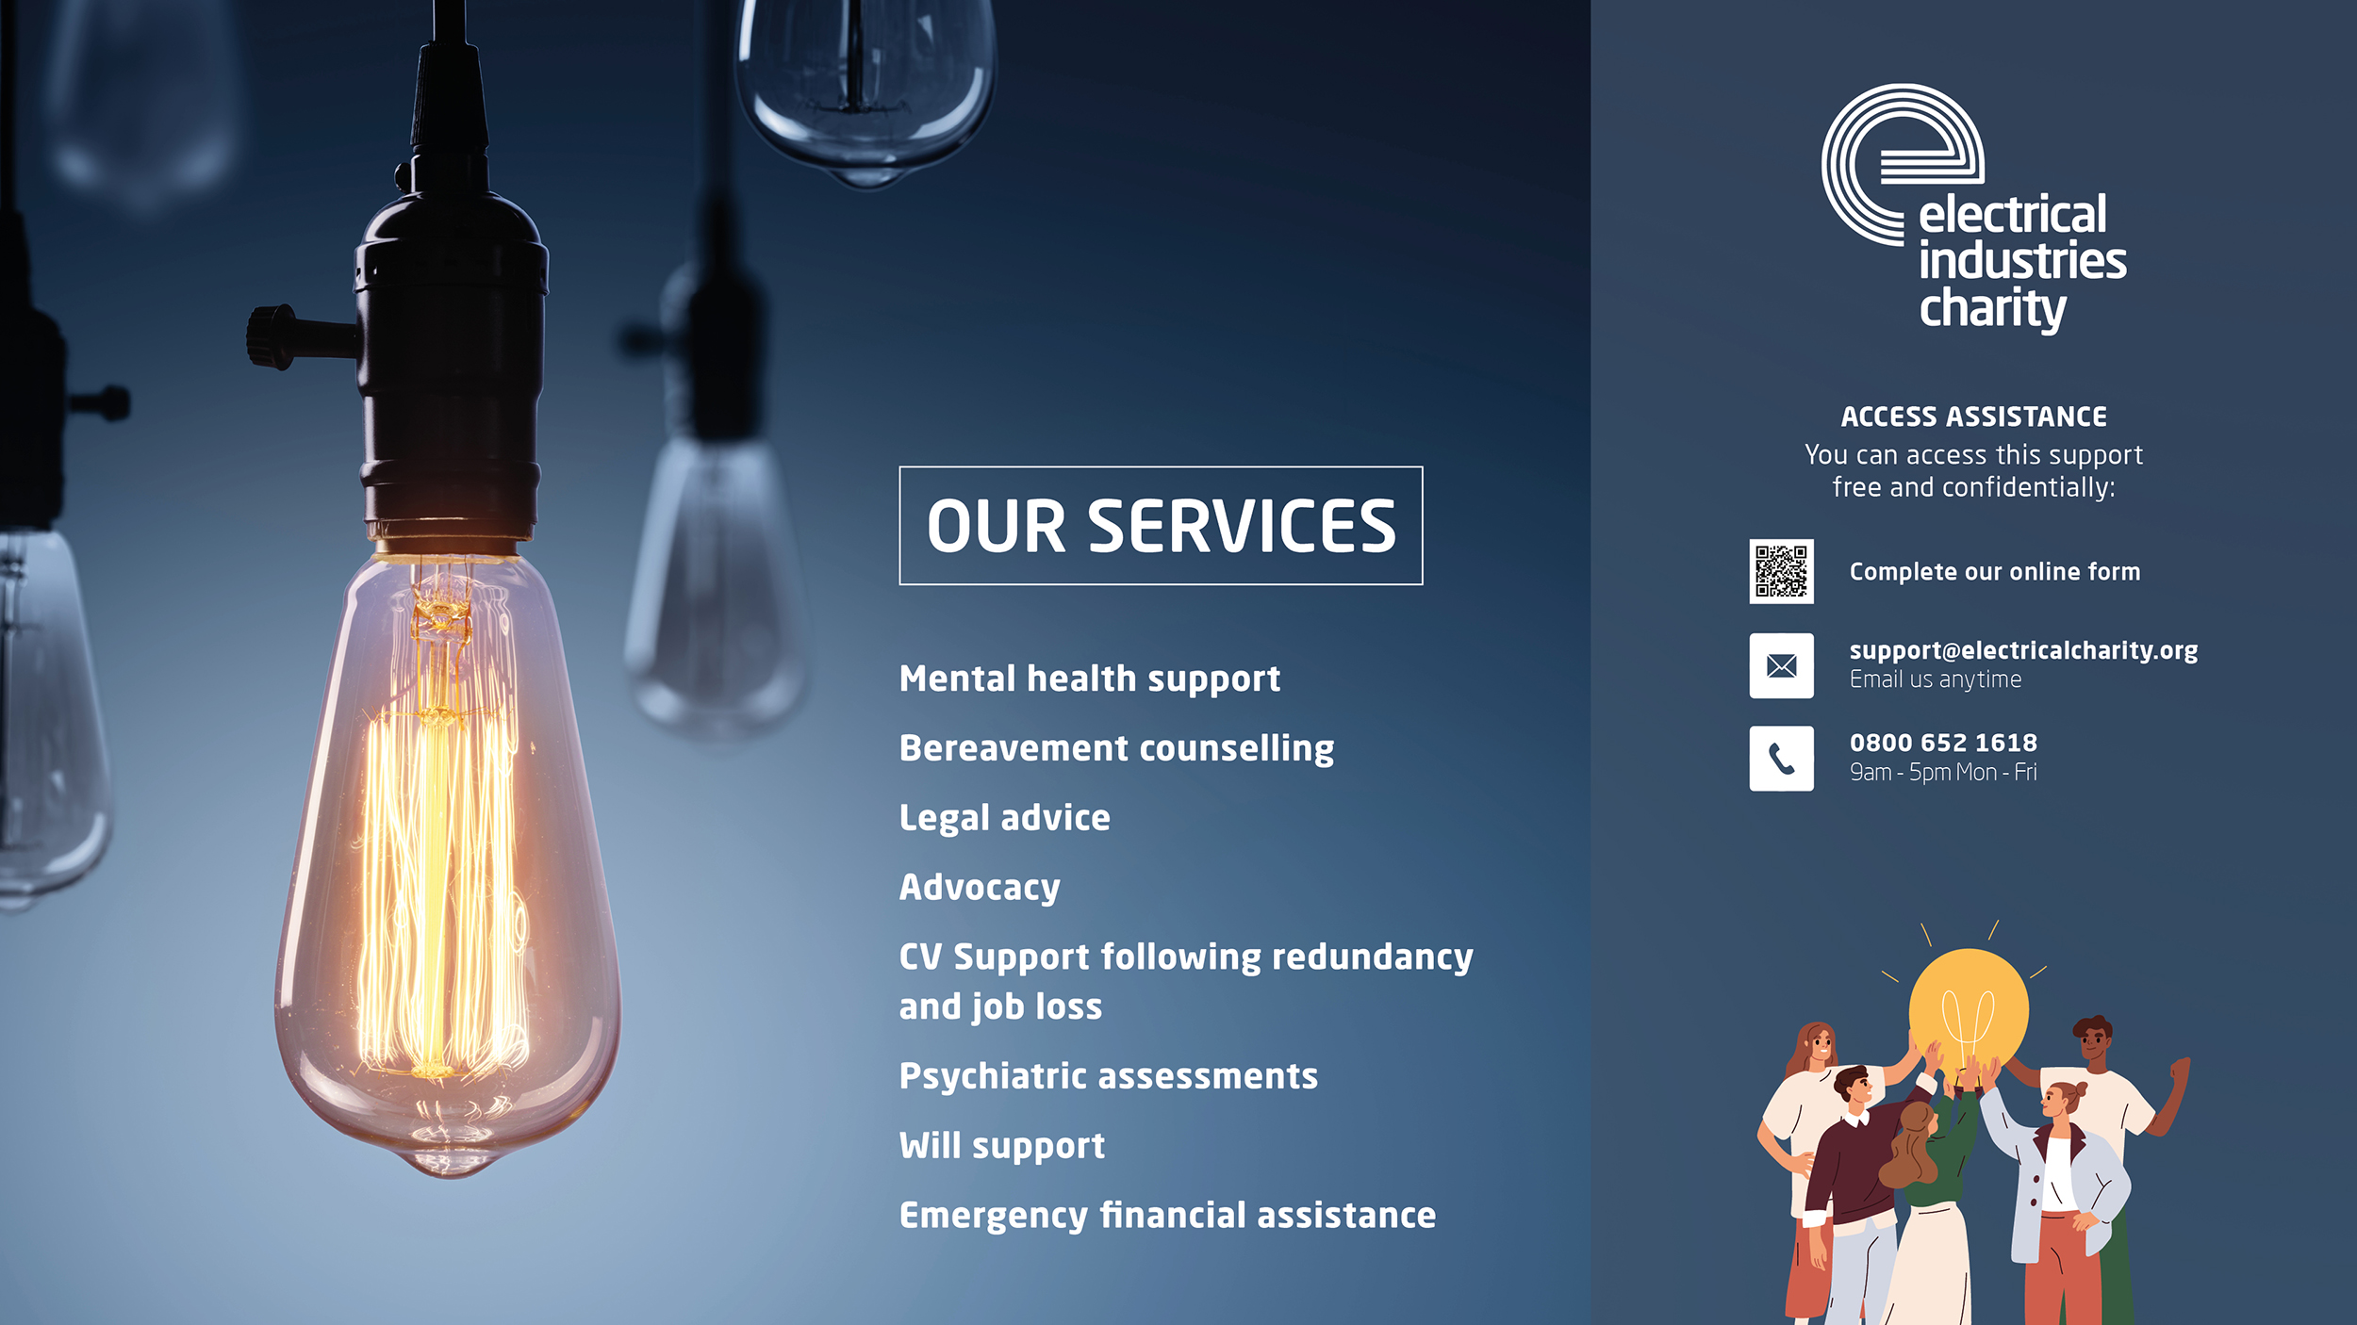
Notes:
People can access our support free and confidentially.
They can complete an online form via the website, email us or call the helpline that is open Monday – Friday, 9am-5pm.
The EIC offers a wide range of services, including mental health support, legal advice, as well as emergency financial assistance. They are very much an umbrella charity that works with various other charity partners to ensure our industry gets the best possible outcome. They are there to get people on the right path
They advocate for people, get everyone together for their journey and set people on the right path.

Slide 5
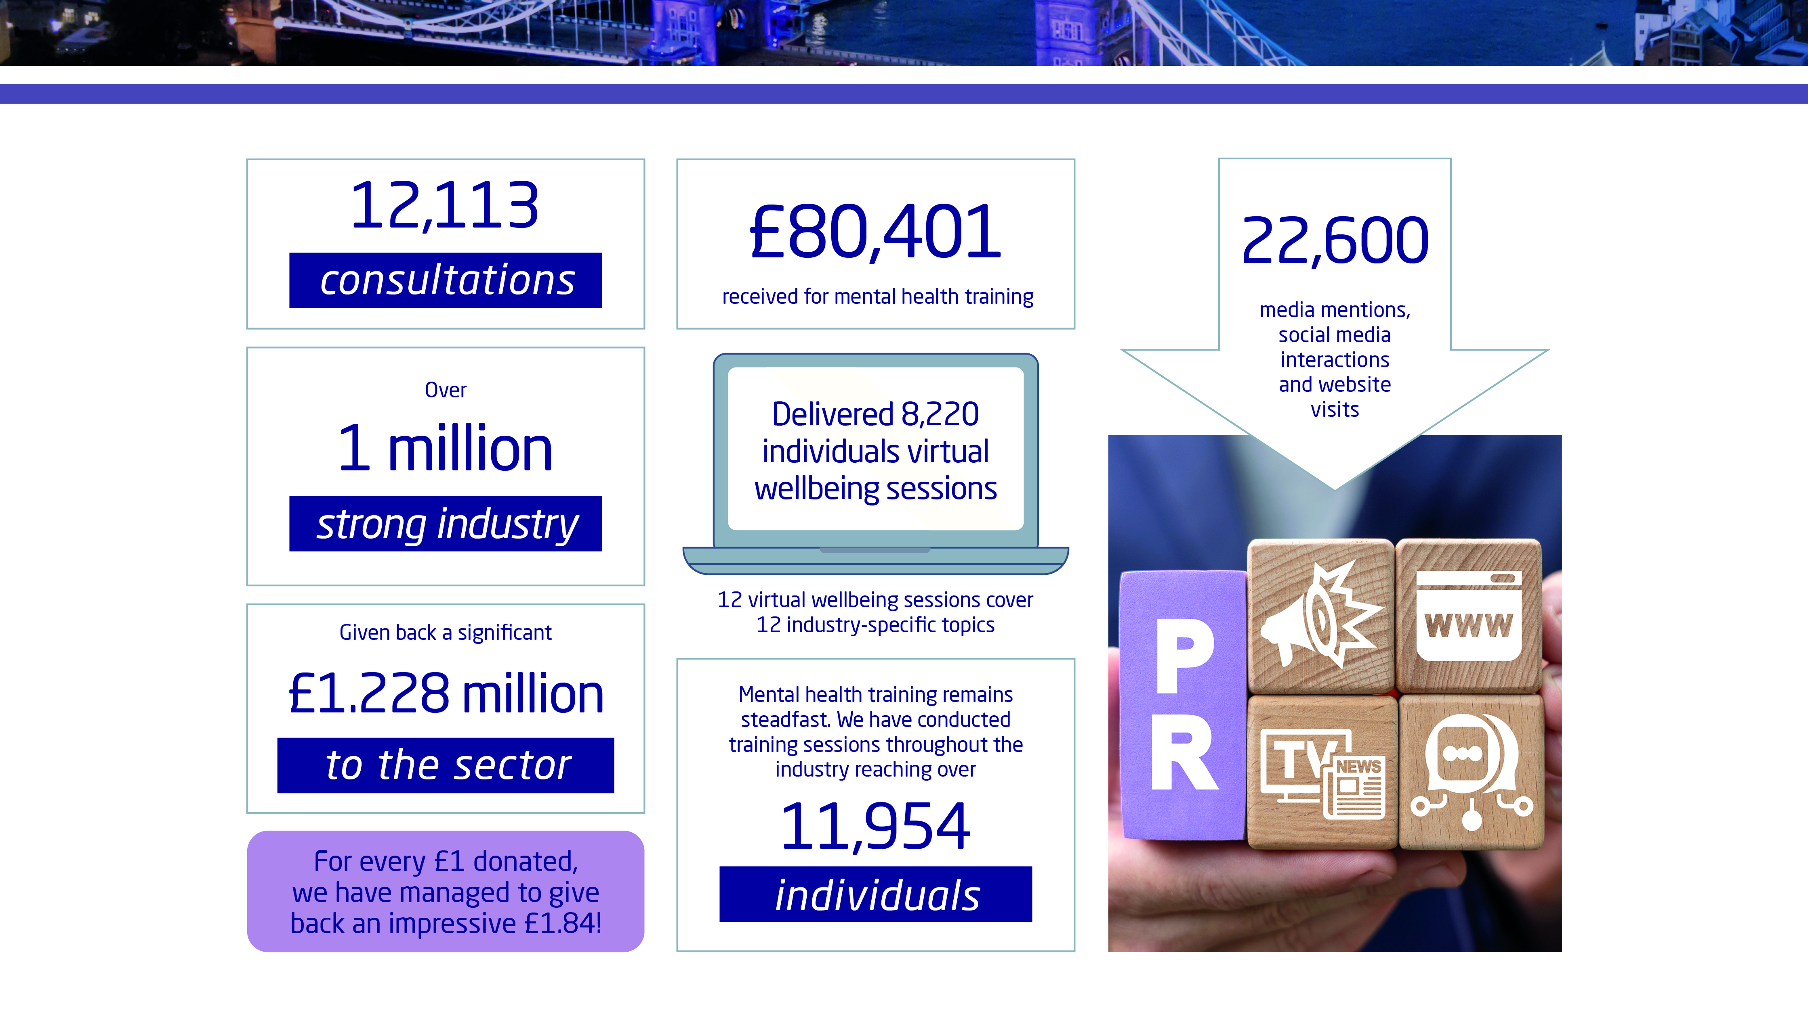
Notes:
We gave back £1.22 million to the industry last year.
For every £1 donated we have increased our give back from £1.64 to £1.84.
We continue to up skill our industry with our virtual wellbeing sessions. Interest continues to increase with over 8,200 individuals attending session last year which is up from 6,891 the year before.
Our small welfare team of 4 completed 12,113 consultations last year – 915 cases up from 789 cases
These figures are from the latest annual review (April 2023 – March 2024).
Every year the charity issues insights and statistics from the industry and the work they do.
They did 12,113 consultations (not individual cases but the number of times we had contact).
They look after an industry that is just over 1 million people and gave back an impressive £1.22 million back to the industry.
They are very proud that for every £1 donated, they gave back £1.84 – which is the highest it’s ever been and a big part of this is our advocacy and working with other charities and organisations.
A big focus of the charity is around prevention and education. To this end they do a lot of training and education. We received £80,401 for mental health training, reaching over 11,954 individuals as well as delivering virtual wellbeing sessions to 8,220 individuals.
Another focus is increasing the awareness of the charity to ensure that everyone who needs their help knows about them, and they had over 22,600 media mentions, social media interactions and website visits.

Slide 6

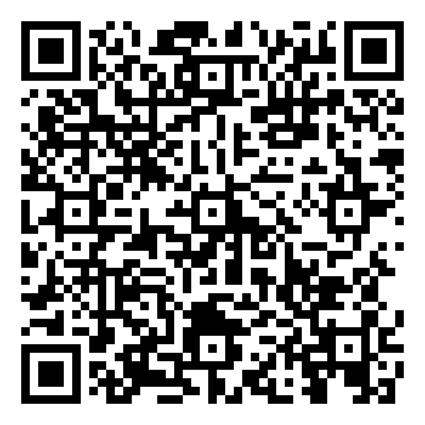
Get Involved
Corporate Donations
120-year anniversary
Join Jess
Training
Apprentice Sponsorship
powerBall
Regional events & sponsorship
Challenge for a Cause
Fundraising
Charity of the year
Ambassador Programme
Checkout Donation
Find out more:
EIC-Get-Involved-2025
Notes:
We rely solely on fundraising and there are many ways to get involved and support the EIC.
Corporate donations: a crucial part of our fundraising and the most straightforward way to support. You can donate at any time and are entitled for tax relief
120-year anniversary: help keep the charity going for another 120 years by donating, becoming one of the 1,000 people to raise £120 each, doing one of our monthly challenges or organise your own fundraising
Join Jess: as part of the 120 celebrations the CEO Jess will be doing 4 challenges across the UK; Zipline in Wales, Kiltwalk in Scotland, abseil in Northern Ireland (London tbc)
Training: the EIC believe that education and understanding is the key to helping mental health in our industry. They offer a range of courses varying from Mental Health awareness, financial awareness through to addiction awareness
Apprentice Sponsorship: we need to look after our young people and every apprentice in the industry can access free of charge mental health training
powerBall: the most prestigious event of the year that is the EIC’s biggest fundraising event. Network with senior colleagues and book your table today (table of 10 £4,995 / platinum table of 10 £10,995). You can also sponsor the event for £15,000
Regional events & sponsorship: there are approx. 30 regional events across the UK to raise vital funds. Great for entertaining customers or bringing your teams. You can buy a table, donate prizes or sponsor the events
powerLottery: sign up for just £1 a month to win some great cash prizes. Why not gift the entry for you employees for as little as £12 per person per Anum
Challenge for a cause: They have different challenges every year from major hikes like Kilimanjaro to cycles across death valley. Anyone can sign up and each participant has a registration fee and fundraising target. You can sponsor this initiative for £15k pa
Fundraising: you can do anything you like to fundraise for the EIC and they have loads of great resources to help you
Charity of the year: make a difference and choose the EIC as your charity of the year. It’s a great way to engage your staff and they will work with you throughout
Ambassador programme: help raise awareness of your industry and become an ambassador
Checkout donation: Why not add an option to your point of sale process for your customers to make a charitable donation?

Slide 7
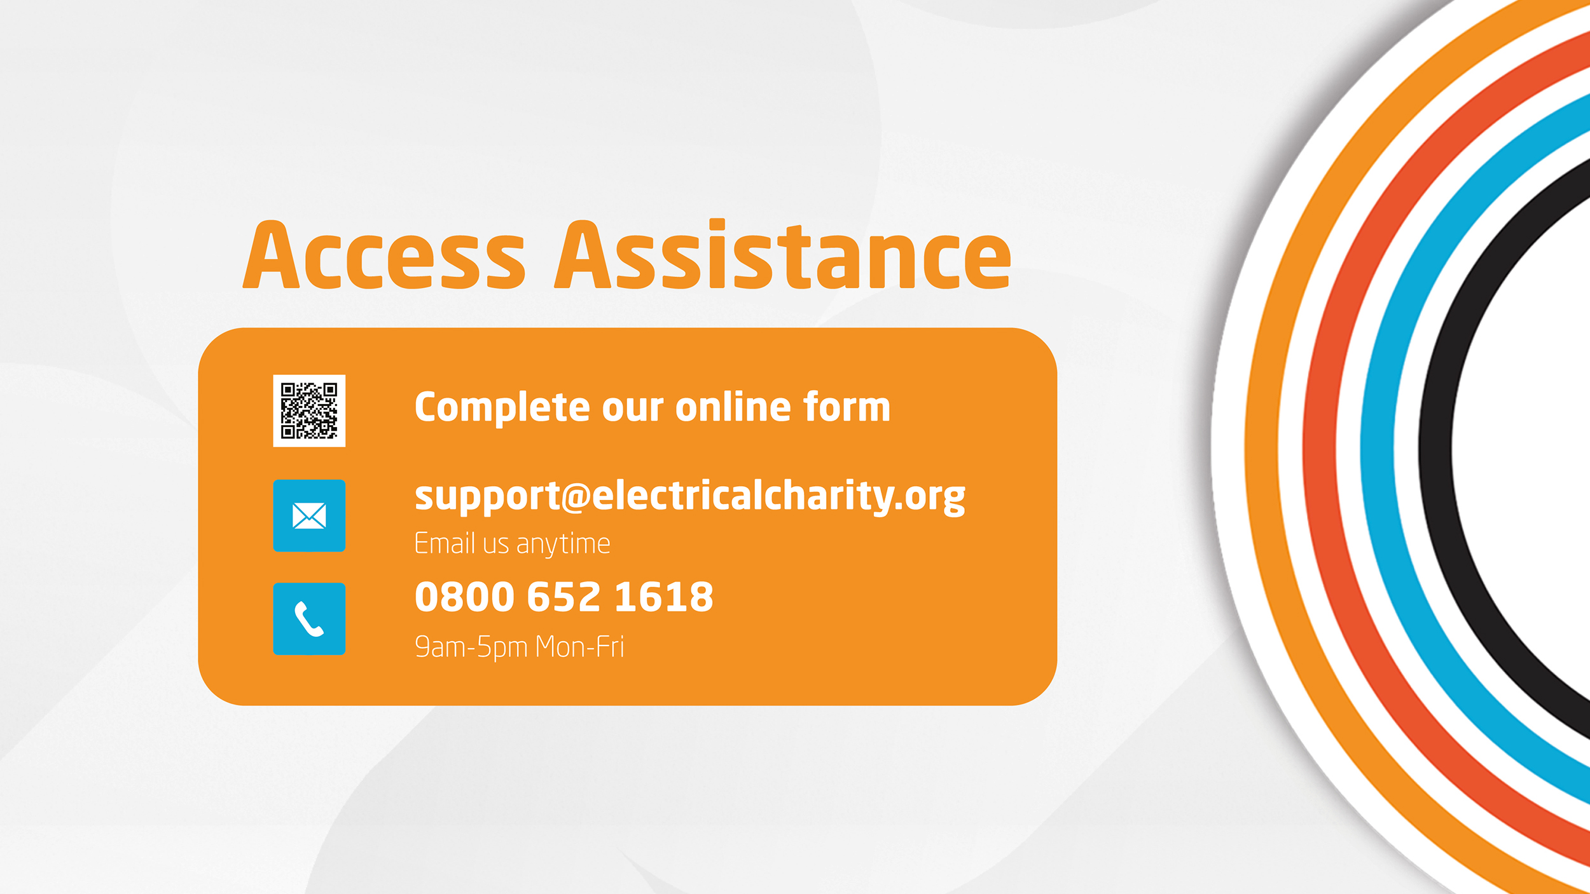
Notes:
Reminder of the way people can access support:
People can access our support free and confidentially.
They can complete an online form via the website, email us or call the helpline that is open Monday – Friday, 9am-5pm.

